Slide 1
A Study in Birthrate Mortality
Team Members
Parris Burton | Mamadou Diallo | Kathryn Davis | Daniel Ta | Tim McCarthy
Questions to Be Answered
KD: Is there a signal between maternal and infant death rates?
PB: What state has the highest and lowest infant mortality rate?
TM: How does poverty rate affect the maternal mortality rate?
MD: Does race factor into infant or maternal mortality rates?
Project Description
Investigate birthrates by state and dig into state/region of the country as well as socioeconomic factors that are impacting mortality of mother and or child.
Datasets to be used:
Census API - https://www.census.gov/data/developers/data-sets.html
CDC CSV Data – https://open.cdc.gov/apis.html

Slide 2
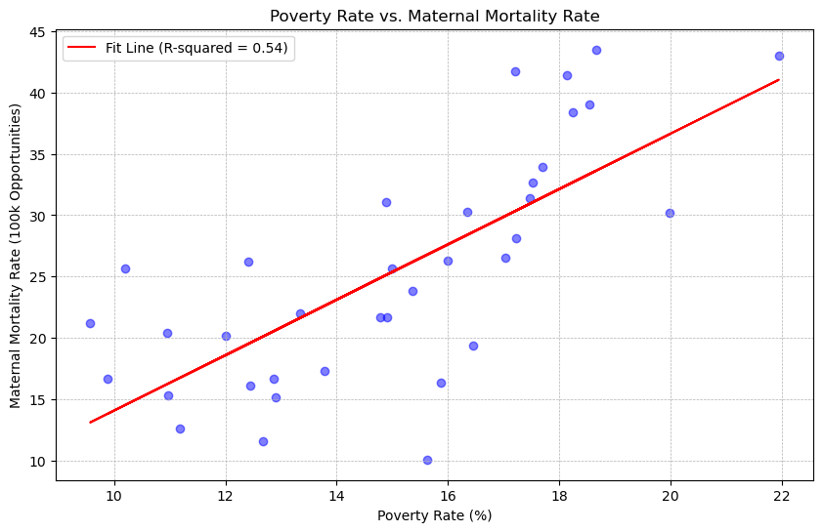
Socioeconomic Impact on Maternal Mortality
Overall Poverty Rate by Maternal Mortality Rate
State Averages
Using state averages for both poverty rate and maternal mortality rate during and after childbirth
It is clear that there is a direct correlation between the poverty rate in a state and the instances of maternal mortality.

Slide 3
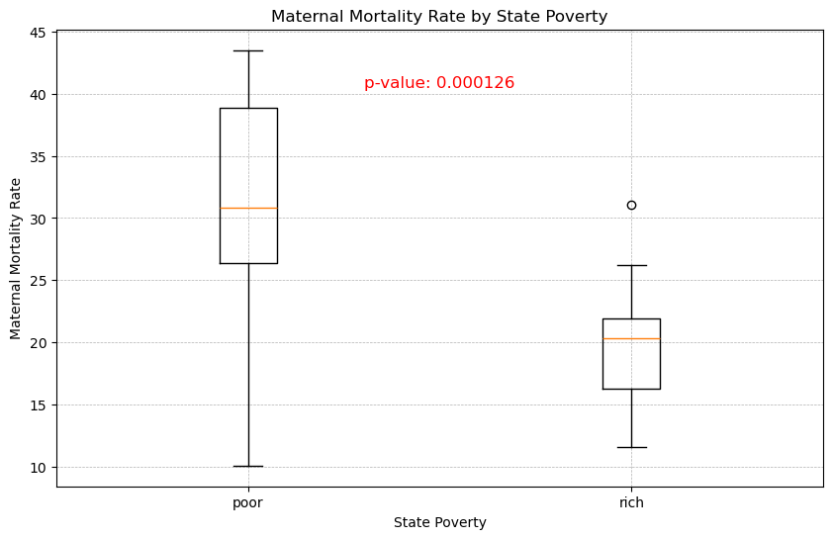
Socioeconomic Impact on Maternal Mortality
Comparison by State Categorization
Combining the 25 poorer states with the 25 richer states, the mortality rate stands out even further.
Women in the poorer states are at a 65% higher risk of maternal death than women in richer states.
P-value is less than 0.05, so we can reject the null hypothesis and assume these samples are statistically significant

Slide 4
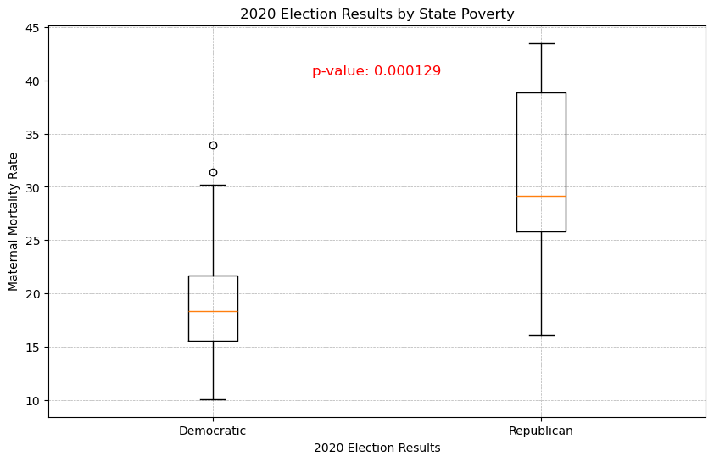
Socioeconomic Impact on Maternal Mortality
Comparison by Political Affiliation
Combining the 25 poorer states with the 25 richer states, the mortality rate stands out even further.
Women in the poorer states are at a 65% higher risk of maternal death than women in richer states.
P-value is less than 0.05, so we can reject the null hypothesis and assume these samples are statistically significant

